Slide 1

VALLURUPALLI NAGESWARA RAO VIGNANA JYOTHI INSTITUTE OF ENGINEERING AND TECHNOLOGY
Department of Computer Science and Engineering
MACHINE LEARNING
Dr. Kriti Ohri
Assistant Professor
Department of Computer Science and Engineering

Slide 2
Why Evaluate?
Multiple methods are available to classify or predict
For each method, multiple choices are available for settings
To choose best model, need to assess each model’s performance

Slide 3
Accuracy Measures (Classification)
Misclassification error
Error = classifying a record as belonging to one class when it belongs to another class.

Slide 4
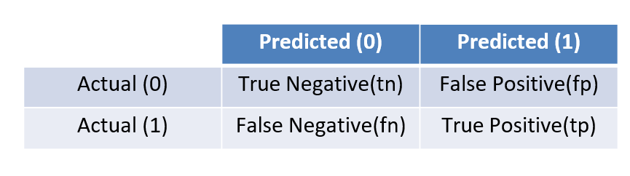
Confusion Matrix
Confusion matrix is a table that is often used to describe the performance of a classification model (or "classifier") on a set of test data for which the true values are known.
Classification Confusion Matrix
 | Predicted Class
Actual Class | 0 | 1
0 | 2689 | 25
1 | 85 | 201
201 1’s correctly classified as “1”
85 1’s incorrectly classified as “0”
25 0’s incorrectly classified as “1”
2689 0’s correctly classified as “0”
0- negative
1-positive

Slide 5
True Positive (TP)
The predicted value matches the actual value
The actual value was positive and the model predicted a positive value
True Negative (TN)
The predicted value matches the actual value
The actual value was negative and the model predicted a negative value
False Positive (FP) – Type 1 error
The predicted value was falsely predicted
The actual value was negative but the model predicted a positive value
Also known as the Type 1 error
False Negative (FN) – Type 2 error
The predicted value was falsely predicted
The actual value was positive but the model predicted a negative value
Also known as the Type 2 error

Slide 6
Accuracy
Accuracy is defined as the percentage of correct predictions for the test data. It can be calculated easily by dividing the number of correct predictions by the number of total predictions

Slide 7
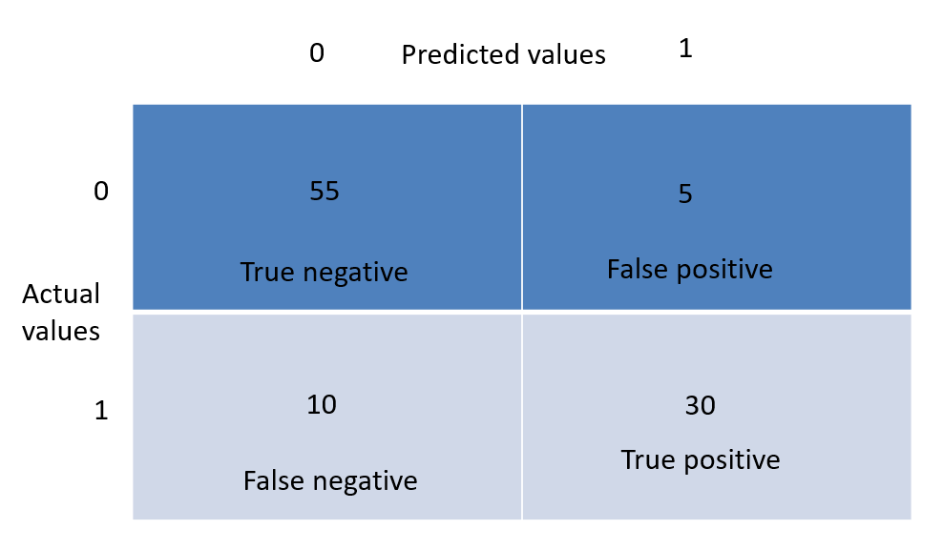
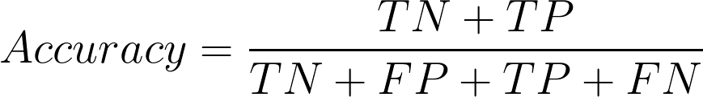
Accuracy = (55 + 30)/(55 + 5 + 30 + 10 ) = 0.85

Slide 8
Interpreting Classification Report
Accuracy = (tp + tn) / (tp + tn + fp + fn)
Precision = tp / (tp + fp)
Recall= tp / (tp + fn)
 | Predicted (0) | Predicted (1)
Actual (0) | tn | fp
Actual (1) | fn | tp

Slide 9
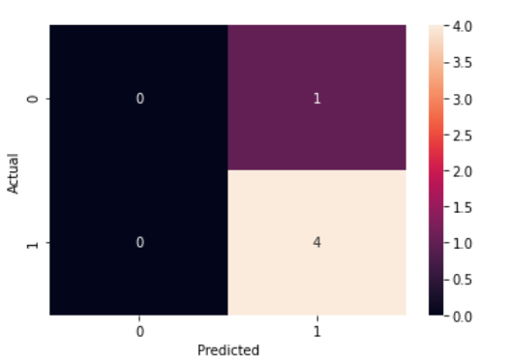
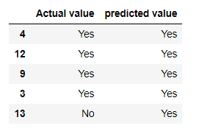
Precision
In the simplest terms, Precision is the ratio between the True Positives and all the Positives.
TN
FN
Precision = tp / (tp + fp)
=4/4+1= 0.8
FP
TP
Out of the total positive results which are made during prediction, which are actual positive

Slide 10
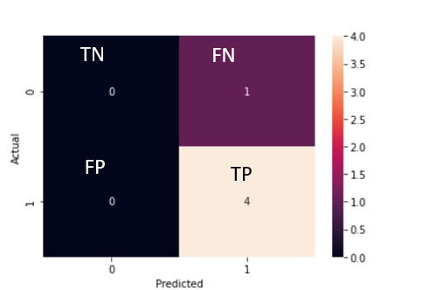
Recall/sensitivity
The recall is the measure of our model correctly identifying True Positives
Recall= tp / (tp + fn)
=4/4+0= 1
Out of the total actual positive values how many positives we predict correctly

Slide 11
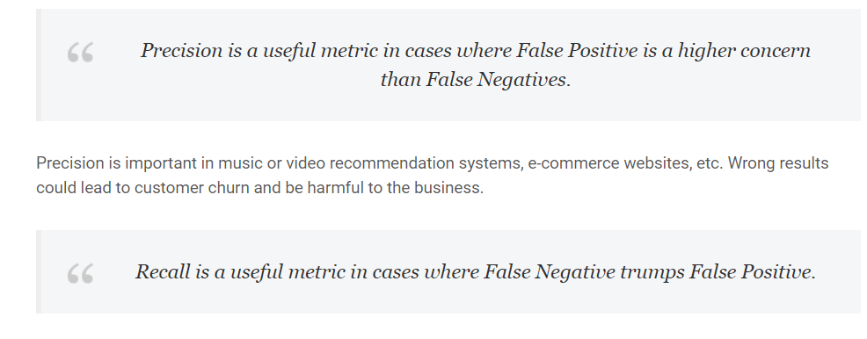
Recall about yes,
gives
when
us an idea
it’s
Precision = tp / (tp + fp)
Recall= tp / (tp + fn)
actually
how often does it
predict yes.
Precision tells us about when it predicts yes, how often is it correct

Slide 12
Consider a matrix like this
0
Predicted values
1
0
90
0
True negative
False positive
Actual values
1
10
0
True positive
False negative

Slide 13
Is accuracy the best measure?
Accuracy may not be a good measure if the dataset is not balanced (both negative and positive classes have different number of data instances). We will explain this with an example.
Consider the following scenario: There are 90 people who are healthy (negative) and 10 people who have some disease (positive). Now let’s say our machine learning model perfectly classified the 90 people as healthy but it also classified the unhealthy people as healthy. What will happen in this scenario? Let us see the confusion matrix and find out the accuracy?

Slide 14
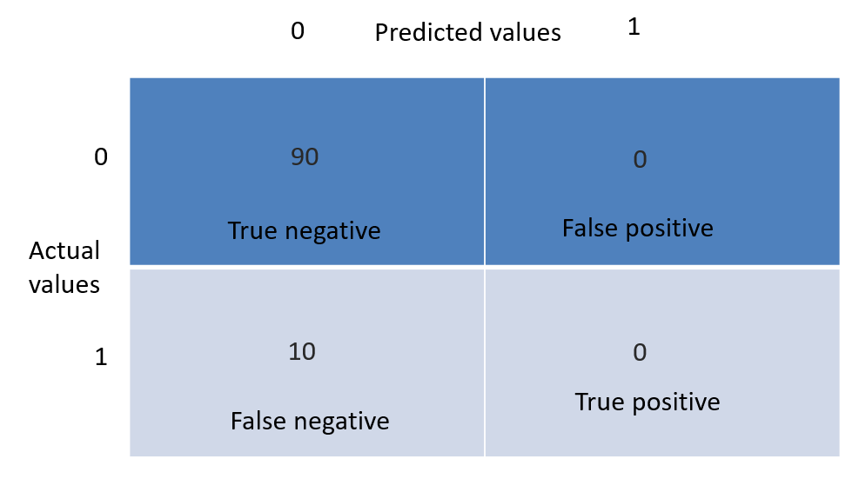
Accuracy in this case will be (90 + 0)/(100) = 0.9 and in percentage the accuracy is 90 %.
Is it good, to use accuracy in this case?- No because its giving good score , even when 10 people were diagnosed without disease when they had.

Slide 15
Precision
Precision should ideally be 1 (high) for a good classifier. Precision becomes 1 only when the numerator and denominator are equal i.e TP = TP +FP, this also means FP is zero. As FP increases the value of denominator becomes greater than the numerator and precision value decreases (which we don’t want).

Slide 16

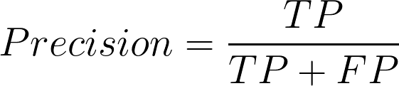
so in the disease example, precision = 30/(30+ 5) = 0.857

Slide 17
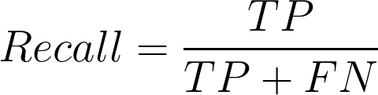
Recall/Sensitivity
Now we will introduce another important metric called recall. Recall is also known as sensitivity or true positive rate and is defined as follows:
Recall should ideally be 1 (high) for a good classifier. Recall becomes 1 only when the numerator and denominator are equal i.e TP = TP +FN, this also means FN is zero. As FN increases the value of denominator becomes greater than the numerator and recall value decreases (which we don’t want).
Recall = 30/(30+ 10) = 0.75

Slide 18

Recall
Recall = 30/(30+ 10) = 0.75

Slide 19
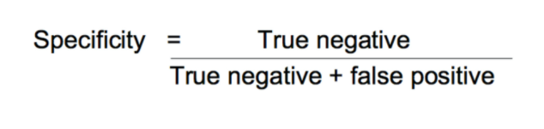
Specificity

Slide 20
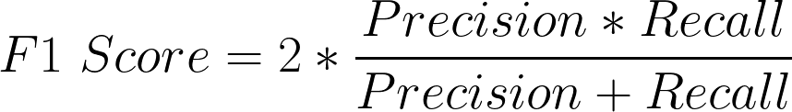
F1 score
So ideally in a good classifier, we want both precision and recall to be one which also means FP and FN are zero. Therefore we need a metric that takes into account both precision and recall. F1-score is a metric which takes into account both precision and recall and is defined as follows:
To balance the up and downsides of optimizing precision and Recall, the harmonic mean of PRE and RE is used.

Slide 21
F1 Score becomes 1 only when precision and recall are both 1. F1 score becomes high only when both precision and recall are high. F1 score is the harmonic mean of precision and recall and is a better measure than accuracy.
In the pregnancy example, F1 Score = 2* ( 0.857 * 0.75)/(0.857 + 0.75) = 0.799.

Slide 22
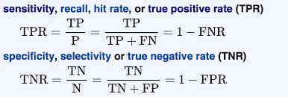

Slide 23
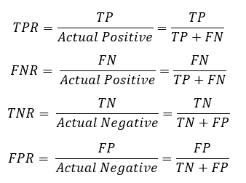

Slide 24
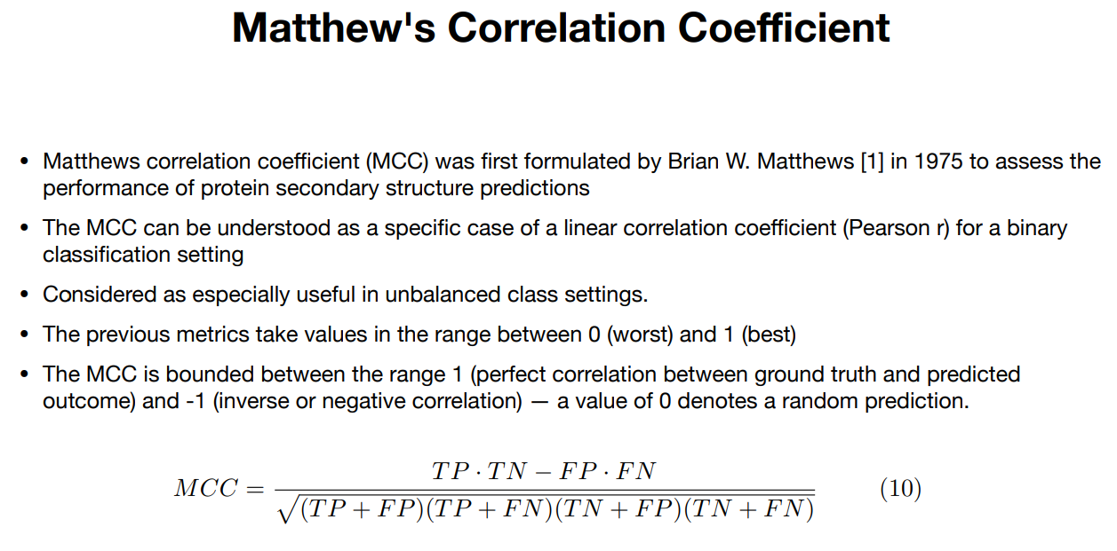

Slide 25
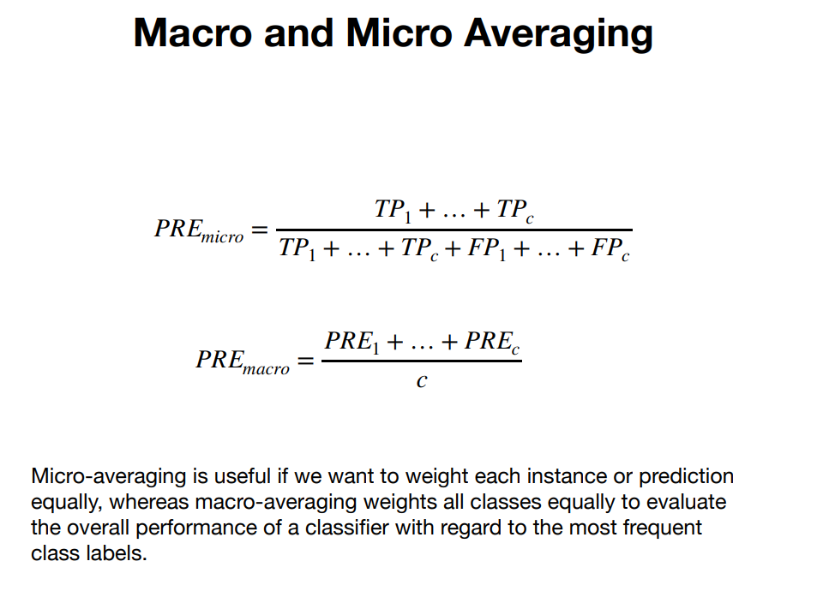

Slide 26
1. Micro Average: Micro averaging calculates the overall metrics by considering each individual instance (sample) equally, regardless of the class to which it belongs. In other words, it aggregates the contributions of all classes to compute the metric.
2. Macro Average: Macro averaging calculates the performance metrics for each class independently and then averages these metrics across all classes. Each class is treated equally, regardless of its size.

Slide 27
Thank You
27

